Slide 1

Project Java and Web Development – Travel App
by Simone Moima
https://github.com/SimoneMoima/DLBCSPJWD01-1

Slide 2
Purpose
This application was designed to help users decide on a holiday destination based on either the current temperature or the monthly average temperature. The user will have to choose one or multiple continents they would consider visiting, as well as one or more of six temperature categories, spanning from freezing (below -1 C°) to very hot (above 33 C°). In case of the monthly average, a month needs to be chosen in addition.
The application will output a list of places, their country and continent, as well as the temperature in C°. The output will be display in descending order from hottest to coldest temperature.
This will help users narrow down on a suitable place to vacate, based on personal temperature preferences.

Slide 3

Architectural Diagram
OpenWeatherMap API
back-end Server
serves JSON response
makes API calls
serves JSON response
Front-end technology:
HTML5
CSS
Vue.js 5
Bootstrap 5.2
Bootstrap-Icons
Back-end technology:
OpenWeatherMap API
Node.js
JavaScript
current temperature Component
average monthly temperature Component
Constant component
front-end
Frameworks
Vue.js Bootstrap
Node.js
uses HTTP
User

Slide 4
The Application
The landingpage has a navigation-bar at the top that leads to the router views – landingpage, travel now and travel later
There is a picture carousel to make the page visually pleasing
Below is a short explanation of the functionality of the app and links to the router views
A note gives information about a drawback of the application
Landingpage

Slide 5
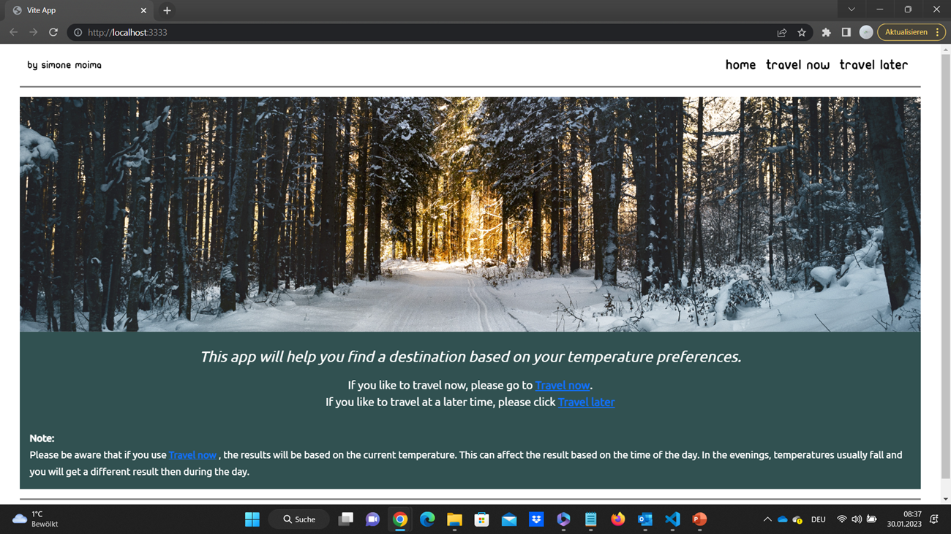

Slide 6
Travel now
This part displays as a result a list of the name of the place, their countries, the continent and the current temperature in Celsius
On top is a navigation bar
On the left is a sidebar with two buttons that link to one of the two main pages (travel now, travel later)
In addition, the sidebar has an offcanvas button that, when clicked, displays a glossary with all the temperature intervals
In the center is a checkbox-form, where one or multiple continents and one or more temperature intervals can be chosen and submitted with a submit button
To the right is a display box that will display all the results
A clear button will reset all choices and results
current temperature values

Slide 7
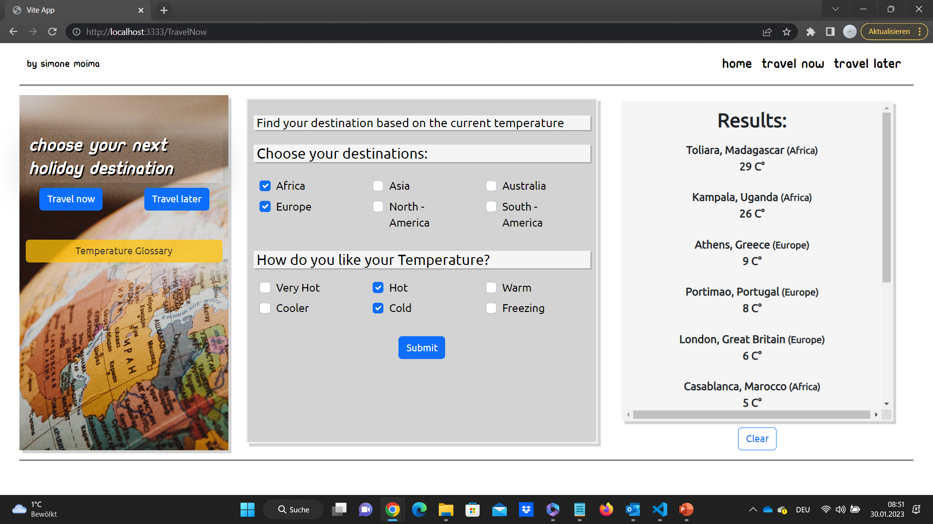

Slide 8
Travel later
This part displays as a result a list of the name of the place, the country, the continent and the average temperature of a chosen month in Celsius
It has a navigation-bar and a sidebar exactly like the travel now page
In the center is a select-bar where a month can be chosen, aswell as checkboxes to choose one or more continents and one or more temperature intervals, a submit button will submit the selection
To the right is a display that will show the results
A clear button will reset all choices and results
Montly average temperature

Slide 9
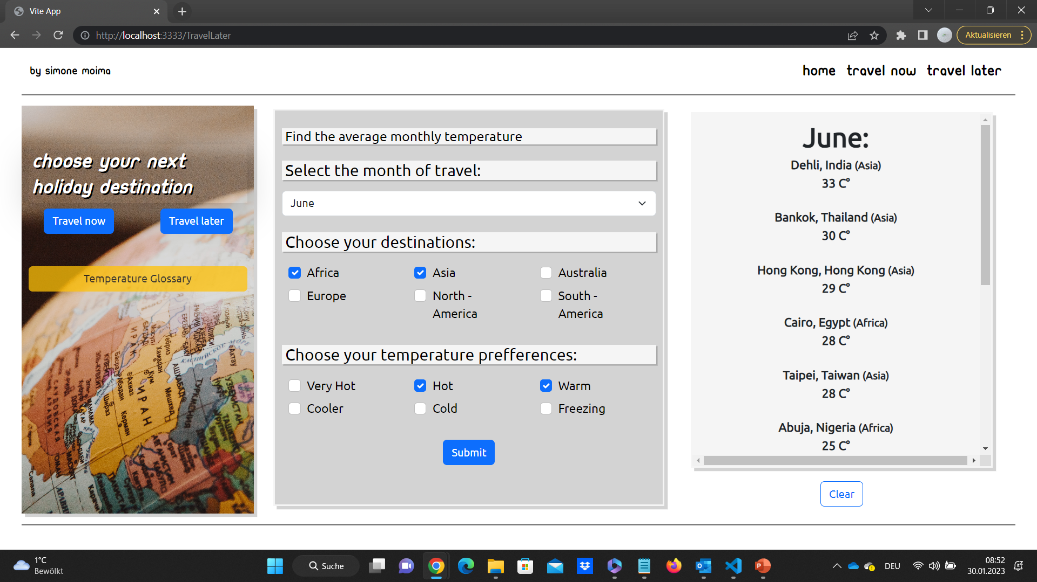

Slide 10
Changes to the original proposal
How to test the app
Follow the README.md instructions on how to install the application environment, preferably through Visual Studio Code
Fork the code from the Git repository
Get a free API key from OpenWeatherMap
To be able to use the Travel Later section, get a free student subscription
Add your API key in the data section of MonthlyAverage.vue and CurrentWeather.vue in the apikey variable
Extra test data is saved as JSON files in the git repository and nothing else needs to be added
Run the application through Vite, which is part of Vue.js
From the landing page, access Travel now and Travel later
Click the desired checkboxes in continent and temperature and if needed, chose a month, then submit by clicking the submit button
To clear the data, click the clear button and start anew
After
Before
Temperature intervals of 10 C° each
Temperature intervals based on how the temperature is perceived
Continents are displayed
A landingpage component was added

Slide 11
